Slide 1
Chapter 2
Functions and Control
Structures
PHP Programming with MySQL
2nd Edition

Slide 2
Objectives
In this chapter, you will:
Study how to use functions to organize your PHP code
Learn about variable scope
Make decisions using if statements, if...else statements, and switch statements
Repeatedly execute while statements, do...while statements, for, and foreach statements
Learn about include and require statements
PHP Programming with MySQL, 2nd Edition

Slide 3
Defining Functions
Functions are groups of statements that you can execute as a single unit
Function definitions are the lines of code that make up a function
The syntax for defining a function is:
  <?php
  function name_of_function(parameters) {
  statements;
  }
  ?>
PHP Programming with MySQL, 2nd Edition

Slide 4
Defining Functions (continued)
Functions, like all PHP code, must be contained within <?php ... ?> tags
A parameter is a variable that is passed to a function when it is called
Parameters are placed within the parentheses that follow the function name
Functions do not have to contain parameters
The set of curly braces (called function braces) contain the function statements
PHP Programming with MySQL, 2nd Edition

Slide 5
Defining Functions (continued)
Function statements do the actual work of
the function and must be contained within the
function braces
  function displayCompanyName($Company1, $Company2, $Company3) {
  echo "<p>$Company1</p>";
  echo "<p>$Company2</p>";
  echo "<p>$Company3</p>";
  }
PHP Programming with MySQL, 2nd Edition

Slide 6
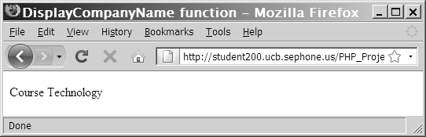
Calling Functions
  function displayCompanyName($CompanyName) {
  echo "<p>$CompanyName</p>";
  }
  displayCompanyName("Course Technology");
Figure 2-1 Output of a call to a custom function
PHP Programming with MySQL, 2nd Edition

Slide 7
Returning Values
A return statement returns a value to the statement that called the function
Not all functions return values
  function averageNumbers($a, $b, $c) {
  $SumOfNumbers = $a + $b + $c;
  $Result = $SumOfNumbers / 3;
  return $Result;
  }
PHP Programming with MySQL, 2nd Edition

Slide 8
Returning Values (continued)
You can pass a function parameter by value or by reference
A function parameter that is passed by value is a local copy of the variable.
A function parameter that is passed by reference is a reference to the original variable.
PHP Programming with MySQL, 2nd Edition

Slide 9
Understanding Variable Scope
Variable scope is where in your program a declared variable can be used
A variable’s scope can be either global or local
A global variable is one that is declared outside a function and is available to all parts of your program
A local variable is declared inside a function and is only available within the function in which it is declared
PHP Programming with MySQL, 2nd Edition

Slide 10
The global Keyword
In PHP, you must declare a global variable with the global keyword inside a function definition to make the variable available within the scope of that function
PHP Programming with MySQL, 2nd Edition

Slide 11
The global Keyword (continued)
<?php
$GlobalVariable = "Global variable";
function scopeExample() {
global $GlobalVariable;
echo "<p>$GlobalVariable</p>";
}
scopeExample();
?>
PHP Programming with MySQL, 2nd Edition

Slide 12
Making Decisions
Decision making or flow control is the process of determining the order in which statements execute in a program
The special types of PHP statements used for making decisions are called decision-making statements or decision-making structures
PHP Programming with MySQL, 2nd Edition

Slide 13
if Statements
Used to execute specific programming code if the evaluation of a conditional expression returns a value of TRUE
The syntax for a simple if statement is:
  if (conditional expression)
  statement;
PHP Programming with MySQL, 2nd Edition

Slide 14
if Statements (continued)
Contains three parts:
  the keyword if
  a conditional expression enclosed within parentheses
  the executable statements
A command block is a group of statements contained within a set of braces
Each command block must have an opening brace ( { ) and a closing brace ( } )
PHP Programming with MySQL, 2nd Edition

Slide 15
if Statements (continued)
$ExampleVar = 5;
if ($ExampleVar == 5) { // condition evaluates to 'TRUE'
echo " <p>The condition evaluates to true.</p> ";
echo '<p>$ExampleVar is equal to ',
" $ExampleVar.</p> ";
echo " <p>Each of these lines will be printed.</p> ";
}
echo " <p>This statement always executes after the if
statement.</p> ";
PHP Programming with MySQL, 2nd Edition

Slide 16
if...else Statements
An if statement that includes an else clause is called an if...else statement
An else clause executes when the condition in an if...else statement evaluates to FALSE
The syntax for an if...else statement is:
if (conditional expression)
statement;
else
statement;
PHP Programming with MySQL, 2nd Edition

Slide 17
if...else Statements (continued)
An if statement can be constructed without the else clause
The else clause can only be used with an if statement
$Today = " Tuesday ";
if ($Today == " Monday ")
echo " <p>Today is Monday</p> ";
    else
    echo " <p>Today is not Monday</p> ";
PHP Programming with MySQL, 2nd Edition

Slide 18
Nested if and if...else Statements
When one decision-making statement is contained within another decision-making statement, they are referred to as nested decision-making structures
  if ($SalesTotal >= 50)
  if ($SalesTotal <= 100)
  echo " <p>The sales total is between 50 and 100, inclusive.</p> ";
PHP Programming with MySQL, 2nd Edition

Slide 19
switch Statements
Control program flow by executing a specific set of statements depending on the value of an expression
Compare the value of an expression to a value contained within a special statement called a case label
A case label is a specific value that contains one or more statements that execute if the value of the case label matches the value of the switch statement’s expression
PHP Programming with MySQL, 2nd Edition

Slide 20
switch Statements (continued)
Consist of the following components:
  The switch keyword
  An expression
  An opening brace
  One or more case labels
  The executable statements
  The break keyword
  A default label
  A closing brace
PHP Programming with MySQL, 2nd Edition

Slide 21
switch Statements (continued)
The syntax for the switch statement is:
  switch (expression) {
  case label:
  statement(s);
  break;
  case label:
  statement(s);
  break;
  ...
  default:
  statement(s);
  break;
  }
PHP Programming with MySQL, 2nd Edition

Slide 22
switch Statements (continued)
A case label consists of:
  The keyword case
  A literal value or variable name
  A colon (:)
A case label can be followed by a single statement or multiple statements
Multiple statements for a case label do not need to be enclosed within a command block
PHP Programming with MySQL, 2nd Edition

Slide 23
switch Statements (continued)
The default label contains statements that execute when the value returned by the switch statement expression does not match a case label
A default label consists of the keyword default followed by a colon (:)
PHP Programming with MySQL, 2nd Edition

Slide 24
Repeating Code
A loop statement is a control structure that repeatedly executes a statement or a series of statements while a specific condition is TRUE or until a specific condition becomes TRUE
There are four types of loop statements:
  while statements
  do...while statements
  for statements
  foreach statements
PHP Programming with MySQL, 2nd Edition

Slide 25
while Statements
Tests the condition prior to executing the series of statements at each iteration of the loop
The syntax for the while statement is:
  while (conditional expression) {
  statement(s);
  }
As long as the conditional expression evaluates to TRUE, the statement or command block that follows executes repeatedly
PHP Programming with MySQL, 2nd Edition

Slide 26
while Statements (continued)
Each repetition of a looping statement is called an iteration
A while statement keeps repeating until its conditional expression evaluates to FALSE
A counter is a variable that increments or decrements with each iteration of a loop statement
PHP Programming with MySQL, 2nd Edition

Slide 27
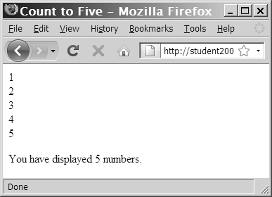
while Statements (continued)
  $Count = 1;
  while ($Count <= 5) {
  echo " $Count<br /> ";
  ++$Count;
  }
  echo " <p>You have printed 5 numbers.</p> ";
Figure 2-5 Output of a while statement using an increment operator
PHP Programming with MySQL, 2nd Edition

Slide 28
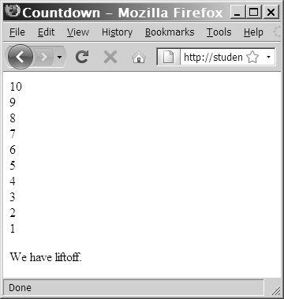
while Statements (continued)
  $Count = 10;
  while ($Count > 0) {
  echo “$Count<br />”;
  --$Count;
  }
  echo " <p>We have liftoff.
  </p> ";
Figure 2-6 Output of a while statement using a decrement operator
PHP Programming with MySQL, 2nd Edition

Slide 29
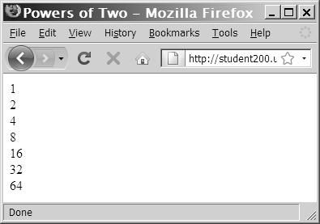
while Statements (continued)
  $Count = 1;
  while ($Count <= 100) {
  echo " $Count<br /> ";
  $Count *= 2;
  }
Figure 2-7 Output of a while statement using the assignment operator *=
PHP Programming with MySQL, 2nd Edition

Slide 30
while Statements (continued)
In an infinite loop, a loop statement never ends because its conditional expression is never FALSE
  $Count = 1;
  while ($Count <= 10) {
  echo " The number is $Count ";
  }
PHP Programming with MySQL, 2nd Edition

Slide 31
do...while Statements
Test the condition after executing a series of statements then repeats the execution as long as a given conditional expression evaluates to TRUE
The syntax for the do...while statement is:
do {
statement(s);
    } while (conditional expression);
PHP Programming with MySQL, 2nd Edition

Slide 32
do...while Statements (continued)
do...while statements always execute once, before a conditional expression is evaluated
  $Count = 2;
  do {
  echo " <p>The count is equal to $Count</p> ";
  ++$Count;
  } while ($Count < 2);
PHP Programming with MySQL, 2nd Edition

Slide 33
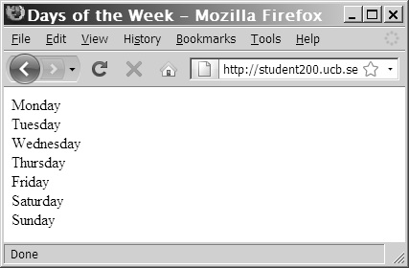
do...while Statements (continued)
$DaysOfWeek = array(" Monday ", " Tuesday ", " Wednesday ", " Thursday ",
" Friday ", " Saturday ", " Sunday ");
$Count = 0;
do {
echo $DaysOfWeek[$Count], "<br />";
++$Count;
} while ($Count < 7);
Figure 2-9 Output of days of week script in Web browser
PHP Programming with MySQL, 2nd Edition

Slide 34
for Statements
Combine the initialize, conditional evaluation, and update portions of a loop into a single statement
Repeat a statement or a series of statements as long as a given conditional expression evaluates to TRUE
If the conditional expression evaluates to TRUE, the for statement executes and continues to execute repeatedly until the conditional expression evaluates to FALSE
PHP Programming with MySQL, 2nd Edition

Slide 35
for Statements (continued)
Can also include code that initializes a counter and changes its value with each iteration
The syntax of the for statement is:
for (counter declaration and initialization; condition;
  update statement) {
  statement(s);
  }
PHP Programming with MySQL, 2nd Edition

Slide 36
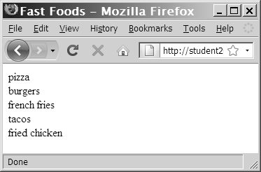
for Statements (continued)
$FastFoods = array(" pizza”, " burgers ", " french fries ", " tacos ", " fried chicken ");
for ($Count = 0; $Count < 5; ++$Count) {
echo $FastFoods[$Count], " <br /> ";
}
Figure 2-10 Output of fast foods script
PHP Programming with MySQL, 2nd Edition

Slide 37
foreach Statements
Used to iterate or loop through the elements in an array
Do not require a counter; instead, you specify an array expression within a set of parentheses following the foreach keyword
The syntax for the foreach statement is:
  foreach ($array_name as $variable_name) {
  statements;
  }
PHP Programming with MySQL, 2nd Edition

Slide 38
foreach Statements (continued)
$DaysOfWeek = array(("Monday", "Tuesday", "Wednesday", "Thursday", "Friday", "Saturday", "Sunday");
foreach ($DaysOfWeek as $Day) {
echo "<p>$Day</p>";
}
PHP Programming with MySQL, 2nd Edition

Slide 39
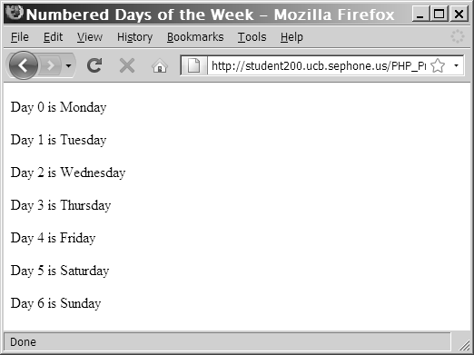
foreach Statements (continued)
$DaysofWeek = array("Monday", "Tuesday", "Wednesday", "Thursday", "Friday", "Saturday", "Sunday");
foreach ($DaysOfWeek as $DayNumber => $Day) {
echo "<p>Day $DayNumber is $Day</p>";
}
Figure 2-11 Output of the foreach script with index values
PHP Programming with MySQL, 2nd Edition

Slide 40
Including Files
The include and require statements reuse content by allowing you to insert the content of an external file on multiple Web pages
  The include statement generates a warning if the include file cannot be found
  The require statement halts the processing of the Web page and displays an error if the include file cannot be found
The include_once and require_once statements assure that the external file is added to the script only one time
PHP Programming with MySQL, 2nd Edition

Slide 41
Summary
The lines that make up a function are called the function definition
A function parameter that is passed by value is a local copy of the variable
A function parameter that is passed by reference is a reference to the original variable
A global variable is declared outside a function and is available to all parts of your program
PHP Programming with MySQL, 2nd Edition

Slide 42
Summary (continued)
A local variable is declared inside a function and is only available within the function in which it is declared
The process of determining the order in which statements execute in a program is called decision making or flow control
The if statement is used to execute specific programming code if the evaluation of a conditional expression returns a value of TRUE
PHP Programming with MySQL, 2nd Edition

Slide 43
Summary (continued)
An if statement that includes an else clause is called an if...else statement. An else clause executes when the condition in an if...else statement evaluates to FALSE
When one decision-making statement is contained within another decision-making statement, they are referred to as nested decision-making structures
PHP Programming with MySQL, 2nd Edition

Slide 44
Summary (continued)
The switch statement controls program flow by executing a specific set of statements, depending on the value of an expression
A loop statement is a control structure that repeatedly executes a statement or a series of statements while a specific condition is TRUE or until a specific condition becomes TRUE
A while statement tests the condition prior to executing the series of statements at each iteration of the loop
PHP Programming with MySQL, 2nd Edition

Slide 45
Summary (continued)
The do...while statement tests the condition after executing a series of statements
The for statement combines the initialize, conditional evaluation, and update portions of a loop into a single statement
The foreach statement is used to iterate or loop through the elements in an array
PHP Programming with MySQL, 2nd Edition

Slide 46
Summary (continued)
The include, require, include_once, and require_once statements insert the contents of an external file at the location of the statement
PHP Programming with MySQL, 2nd Edition

